Slide 1
Learning Models From Data
Yangge Li
ECE 584

Slide 2
Motivation
Models are essential to verification. However, we do not have access to models.
Creating models based on physics laws can be time consuming and the models may also not accurate be enough.
Use deep learning to efficiently learn model dynamics from example executions.

Slide 3
Related Work
Control an autonomous helicopter through apprenticeship learning. [1]
Use Rectified Linear Unit Network Model to represent the dynamics of helicopter. [2]
Employ a neural network based dynamics model to synthesize control for trajectories. [3]
Notes:
Pieter Abbeel, Somil Bansal

Slide 4
Objective
The goal of the project is to use deep learning to approximate the dynamics of vehicles.
Try to “learn” the model that can properly approximate the behavior of a vehicle from example running.
The neural network model should be simple so that it is possible to further interpret the model.

Slide 5

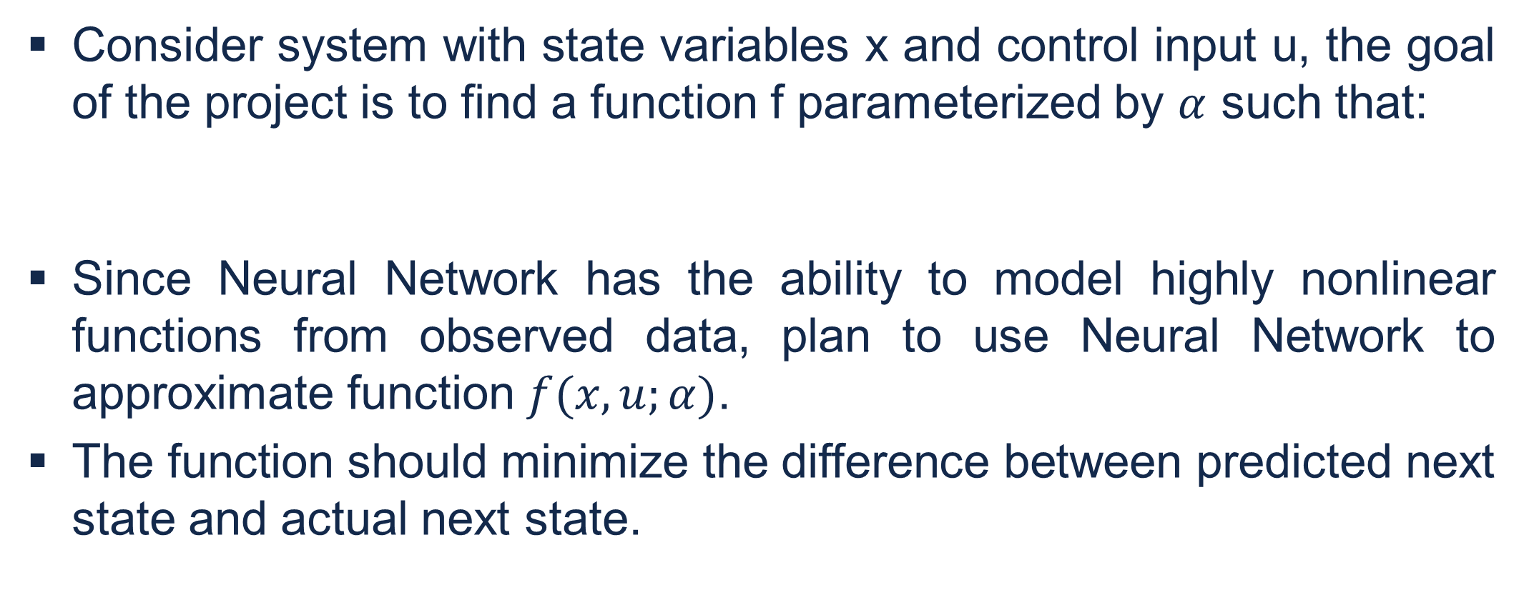
Problem Description
Consider system with state variables x and control input u, the goal of the project is to find a function f parameterized by $α$ such that:
Since Neural Network has the ability to model highly nonlinear functions from observed data, plan to use Neural Network to approximate function $f(x,u;α)$.
The function should minimize the difference between predicted next state and actual next state.

Slide 6
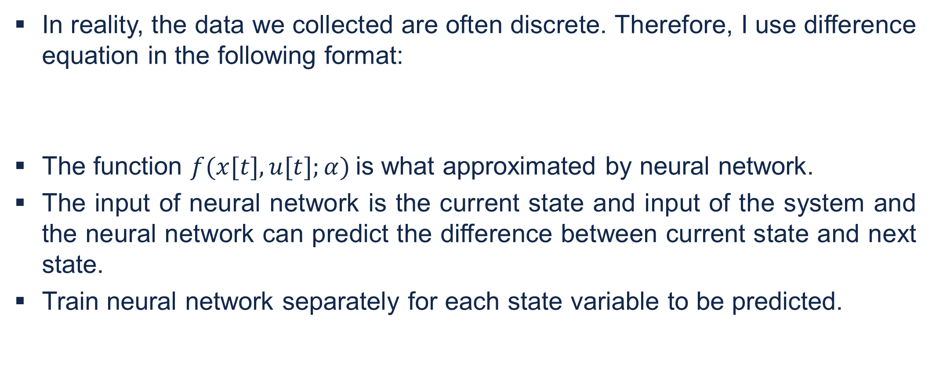
Problem Description
In reality, the data we collected are often discrete. Therefore, I use difference equation in the following format:
The function $f(x[t],u[t];α)$is what approximated by neural network.
The input of neural network is the current state and input of the system and the neural network can predict the difference between current state and next state.
Train neural network separately for each state variable to be predicted.

Slide 7
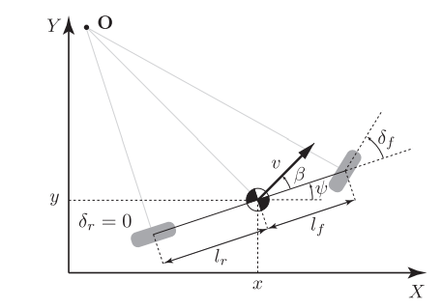
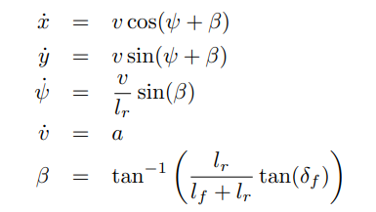

Vehicle Model
To simplify the procedure of collecting data, using data from simulation.
Use the kinetic bicycle model from [4] and odeint to collect simulation data. The model I am using is shown below.
In the experiment, I choose $l_{r}=3$, $l_{f}=5$. To simplify the problem, I set the longitudinal speed to be constant, and therefore $v_{0}=3$ and $a=0$. In addition, I restrict the turning angle of the vehicle to be between -30 to 30 degree.
Notes:
Much easier to obtain training data testing data.
Have 4 state variables, x, y, position
Psi, orientation, v speed
Two input, a and delta

Slide 8
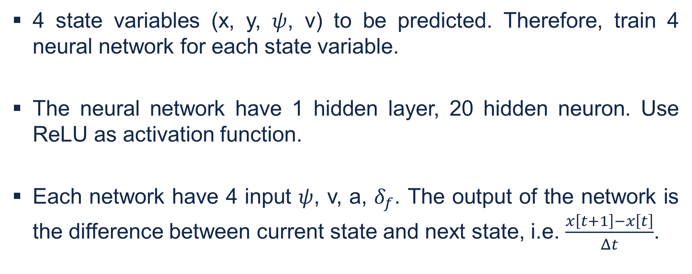
Neural Network Structure
4 state variables (x, y, $ψ$, v) to be predicted. Therefore, train 4 neural network for each state variable.
The neural network have 1 hidden layer, 20 hidden neuron. Use ReLU as activation function.
Each network have 4 input $ψ$, v, a, $δ_{f}$. The output of the network is the difference between current state and next state, i.e. $\frac{x\left[t+1\right]−x\left[t\right]}{Δt}$.

Slide 9
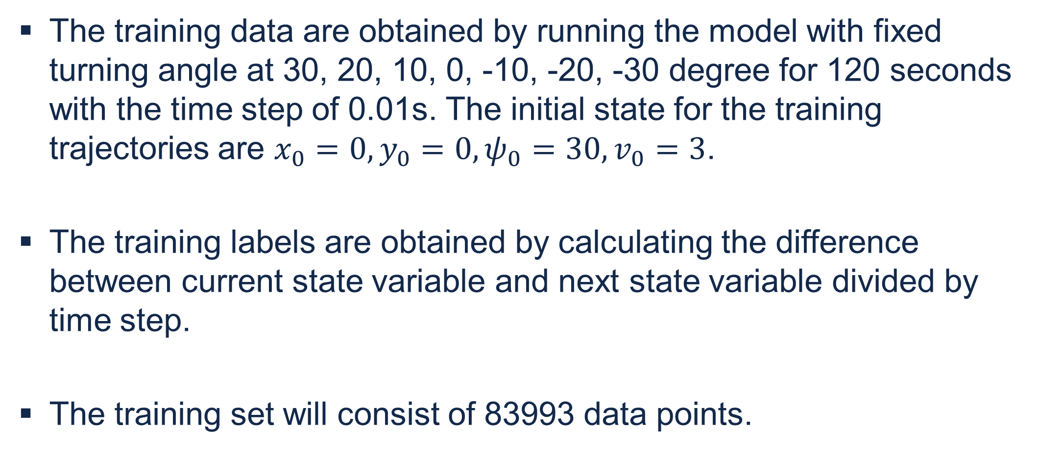
Training Data and Label
The training data are obtained by running the model with fixed turning angle at 30, 20, 10, 0, -10, -20, -30 degree for 120 seconds with the time step of 0.01s. The initial state for the training trajectories are $x_{0}=0, y_{0}=0, ψ_{0}=30, v_{0}=3$.
The training labels are obtained by calculating the difference between current state variable and next state variable divided by time step.
The training set will consist of 83993 data points.

Slide 10
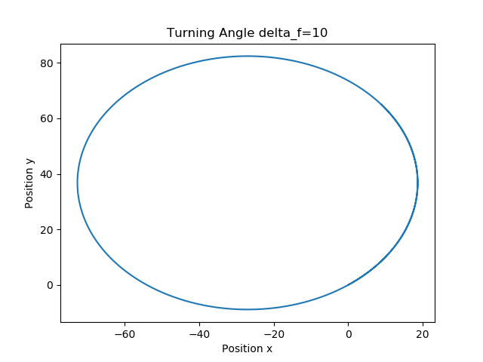
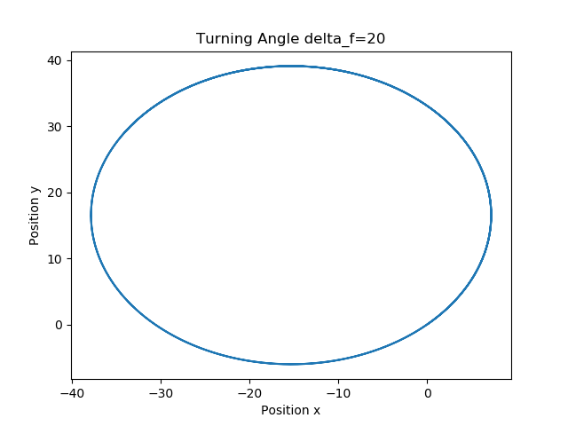
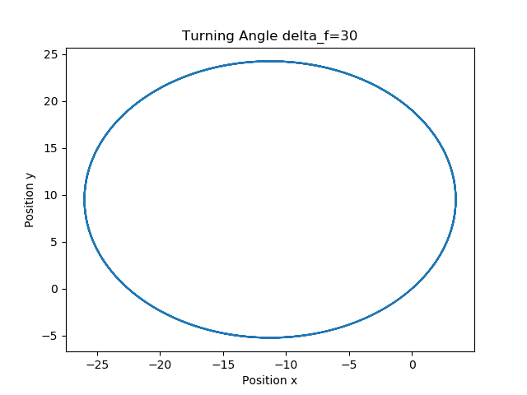
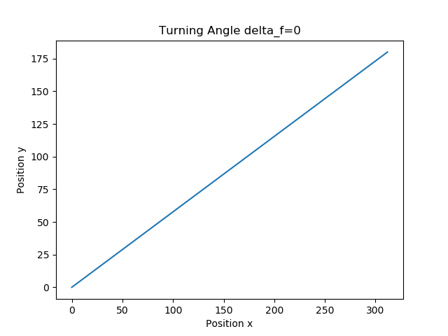
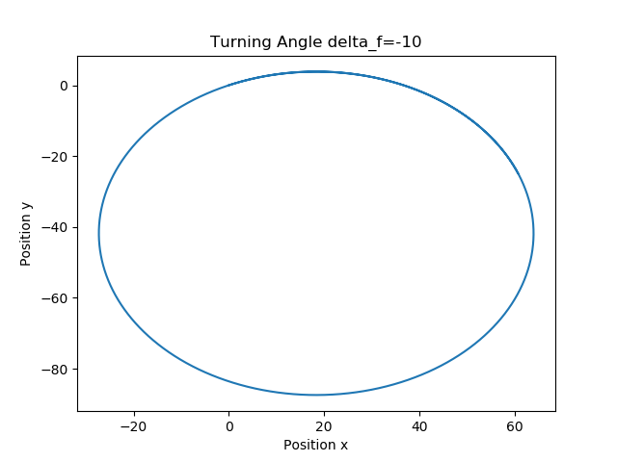
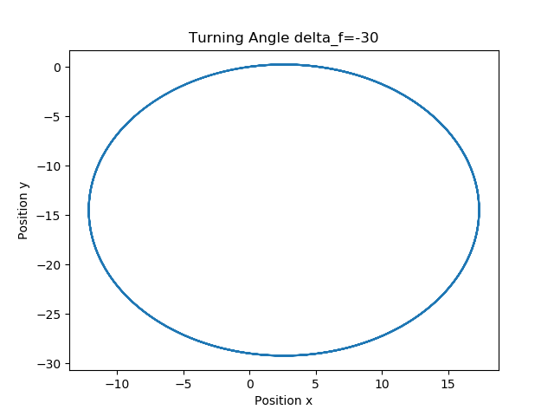
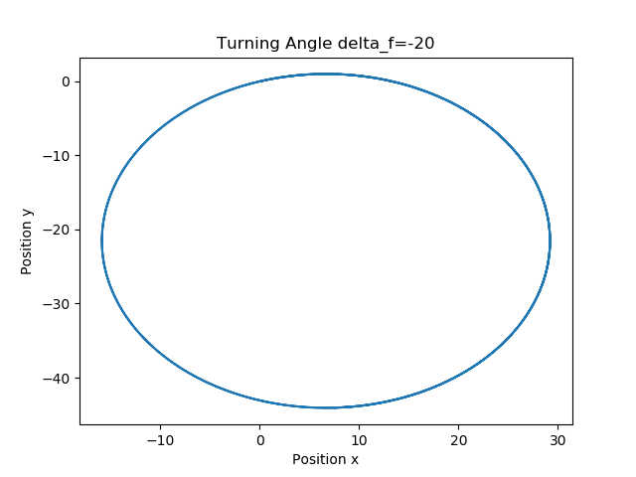
Trajectories for Training

Slide 11
Experiment Result
To test the performance of the model I obtained. I compute trajectories inductively using my model with random initial state and time varying input (turning angle) between -30 to 30 degree.
Reference trajectory is obtained by performing simulation with same initial state and same input sequence.
Simulation results are compared with trajectory calculated from my model.

Slide 12
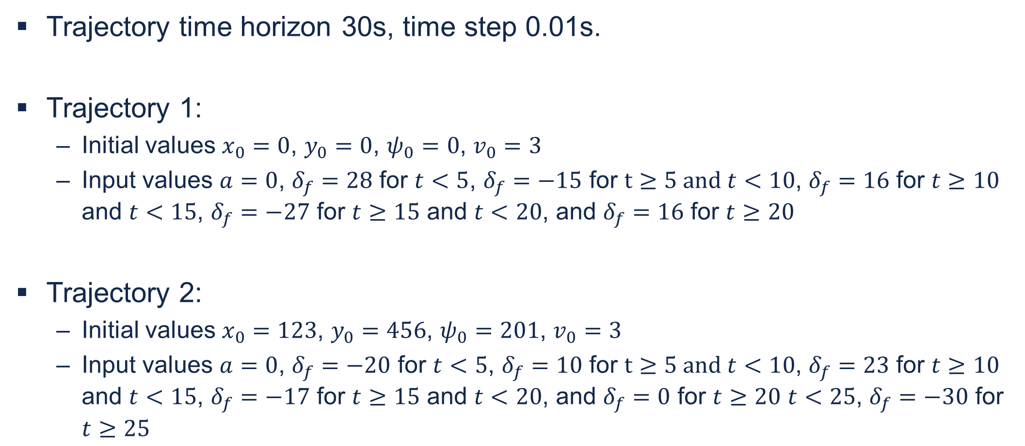
Experiment Result
Trajectory time horizon 30s, time step 0.01s.
Trajectory 1:
Initial values $x_{0}=0$, $y_{0}=0$, $ψ_{0}=0$, $v_{0}=3$
Input values $a=0$, $δ_{f}=28$ for $t<5$, $δ_{f}=−15$ for $t≥5 and t<10$, $δ_{f}=16$ for $t≥10$ and $t<15$, $δ_{f}=−27$ for $t≥15$ and $t<20$, and $δ_{f}=16$ for $t≥20$
Trajectory 2:
Initial values $x_{0}=123$, $y_{0}=456$, $ψ_{0}=201$, $v_{0}=3$
Input values $a=0$, $δ_{f}=−20$ for $t<5$, $δ_{f}=10$ for $t≥5 and t<10$, $δ_{f}=23$ for $t≥10$ and $t<15$, $δ_{f}=−17$ for $t≥15$ and $t<20$, and $δ_{f}=0$ for $t≥20$ $t<25$, $δ_{f}=−30$ for $t≥25$
Notes:
One thing to note that none of this trajectories appeared in the training data set. In addition, the some of the input are never encountered during training.

Slide 13
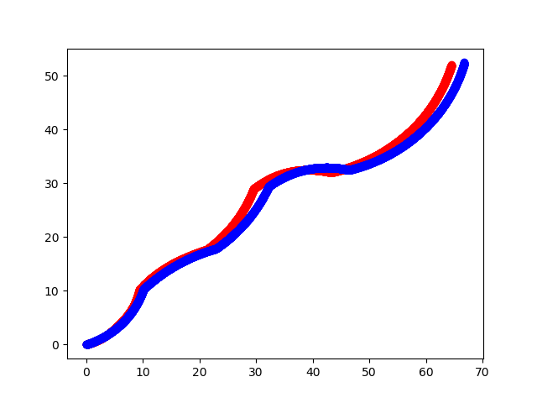
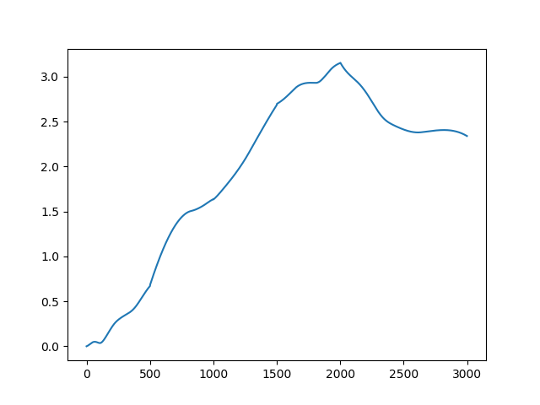
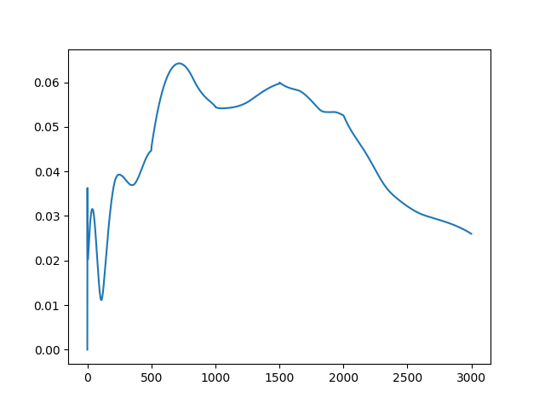
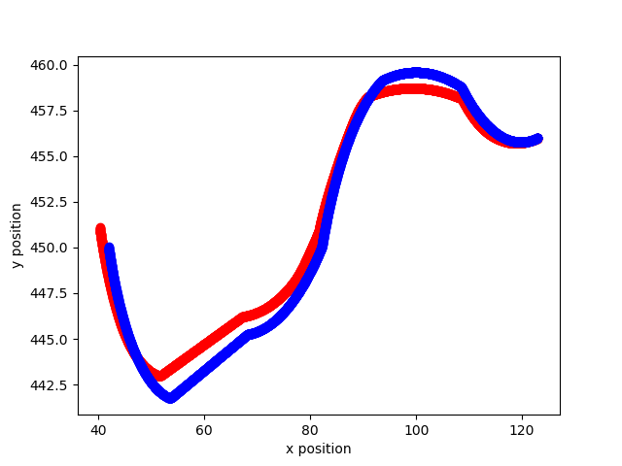
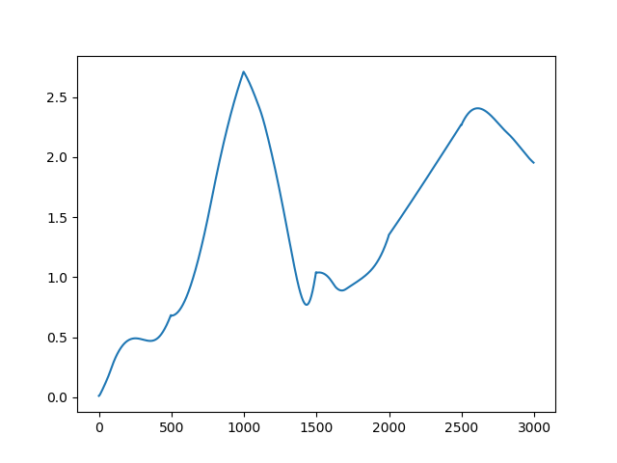
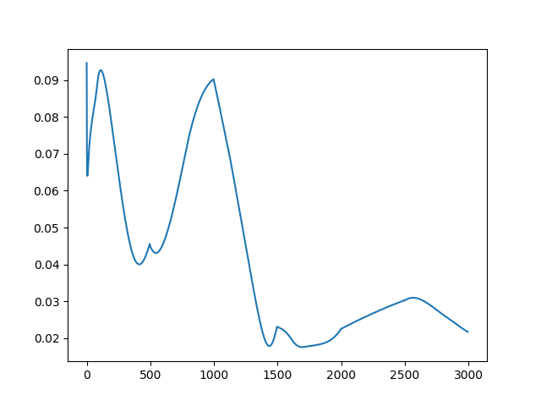
Experiment Result
Notes:
Plots the position of the vehicle
Blue is reference, red is what predicted by my model
Middle two figures shows the difference between reference trajectory and predicted trajectory at each time step. Expect the difference to accumulate since the predicted trajectory is obtained inductively from initial state. However, not really the case.
The fraction of difference between reference trajectory and predicted trajectory over the total distance traveled. In general, the error is relatively small compared with the total distance traveled.

Slide 14
Conclusion
Neural network have the ability to approximate the dynamics of systems through example running data.
Even a network with really simple structure is able to model system with complexity.
The neural network have some ability to handle situation that is not presented in the training set.

Slide 15
Future Work
Collecting data from real vehicle running. Candidate vehicles are F1/10th small car or GEM car.
Possible to link the neural network model with verification tools.
Possible to use the learned model in path planner or for controller synthesis.

Slide 16
Reference
[1] Abbeel, P., Coates, A., & Ng, A. Y. (2010). Autonomous Helicopter Aerobatics through Apprenticeship Learning. The International Journal of Robotics Research, 29(13), 1608–1639. https://doi.org/10.1177/0278364910371999
[2] A. Punjani and P. Abbeel, "Deep learning helicopter dynamics models," 2015 IEEE International Conference on Robotics and Automation (ICRA), Seattle, WA, 2015, pp. 3223-3230.
[3] S. Bansal, A. K. Akametalu, F. J. Jiang, F. Laine and C. J. Tomlin, "Learning quadrotor dynamics using neural network for flight control," 2016 IEEE 55th Conference on Decision and Control (CDC), Las Vegas, NV, 2016, pp. 4653-4660.
[4] J. Kong, M. Pfeiffer, G. Schildbach and F. Borrelli, "Kinematic and dynamic vehicle models for autonomous driving control design," 2015 IEEE Intelligent Vehicles Symposium (IV), Seoul, 2015, pp. 1094-1099.

Slide 17
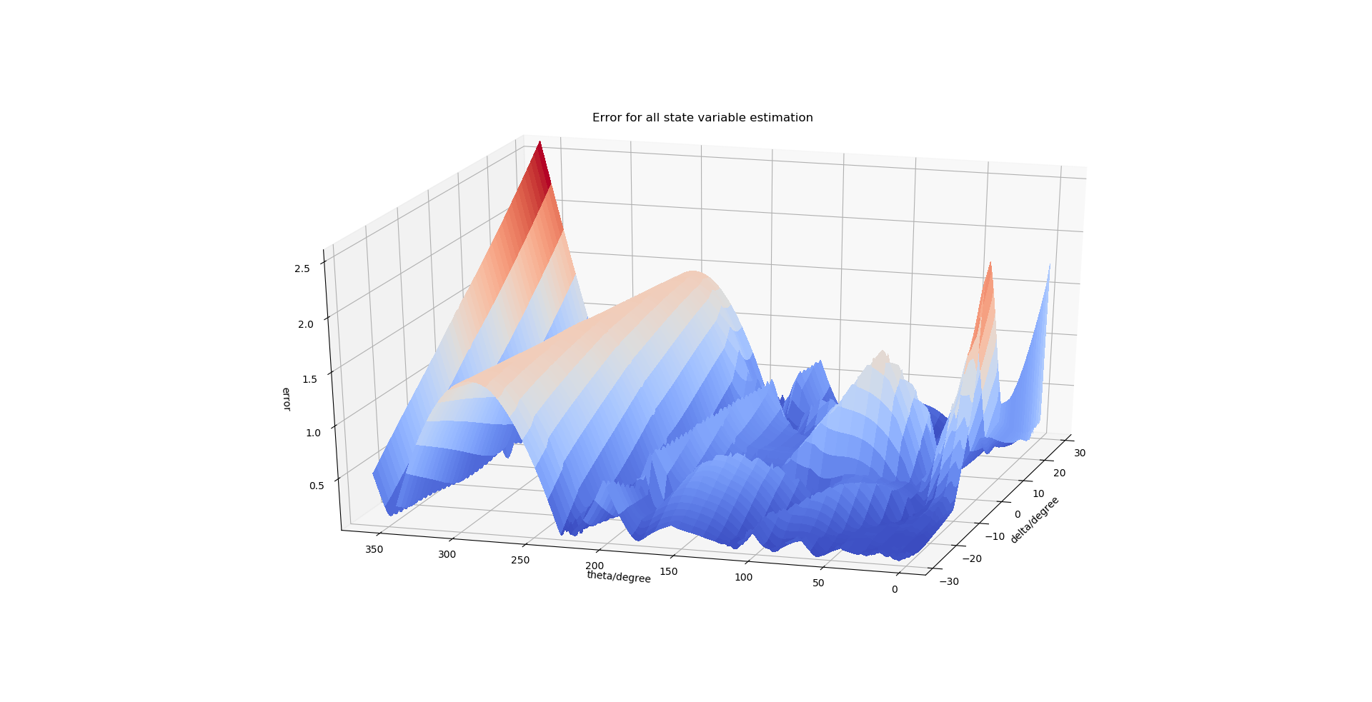
Experiment Result

Slide 18
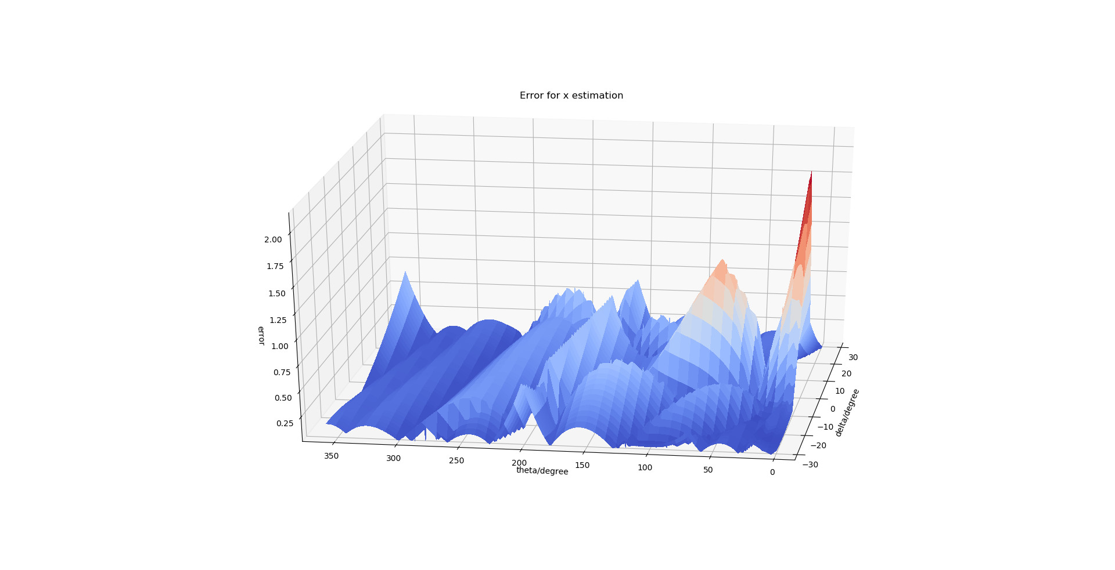
Experiment Result

Slide 19
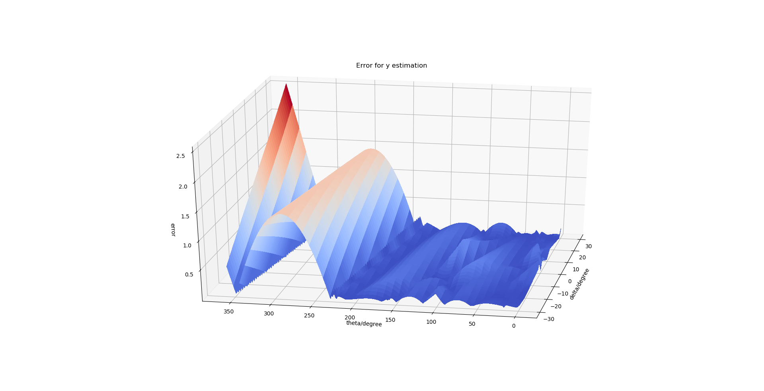
Experiment Result

Slide 20
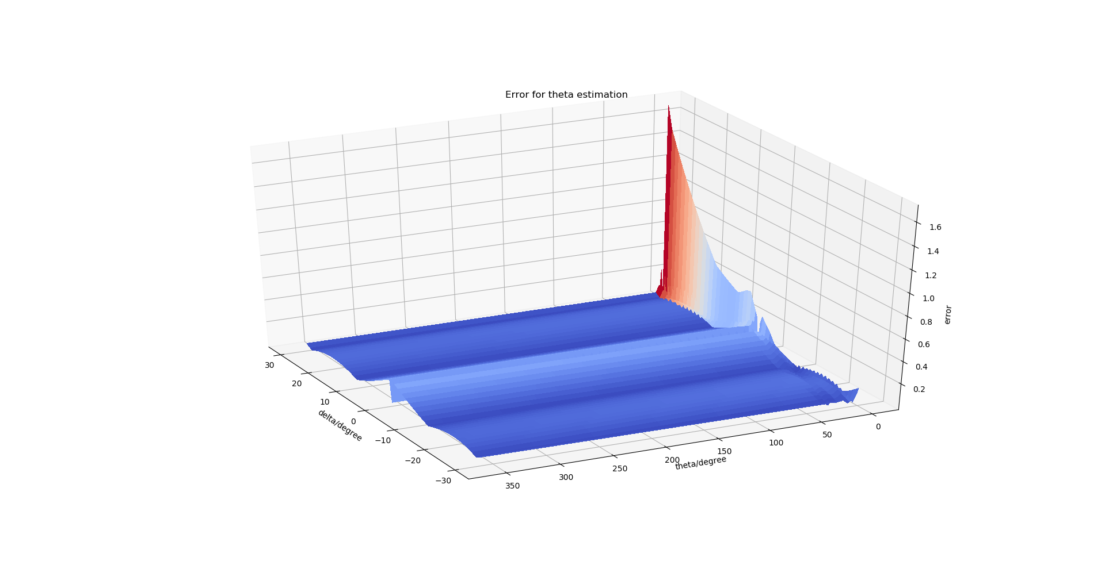
Experiment Result

Slide 21
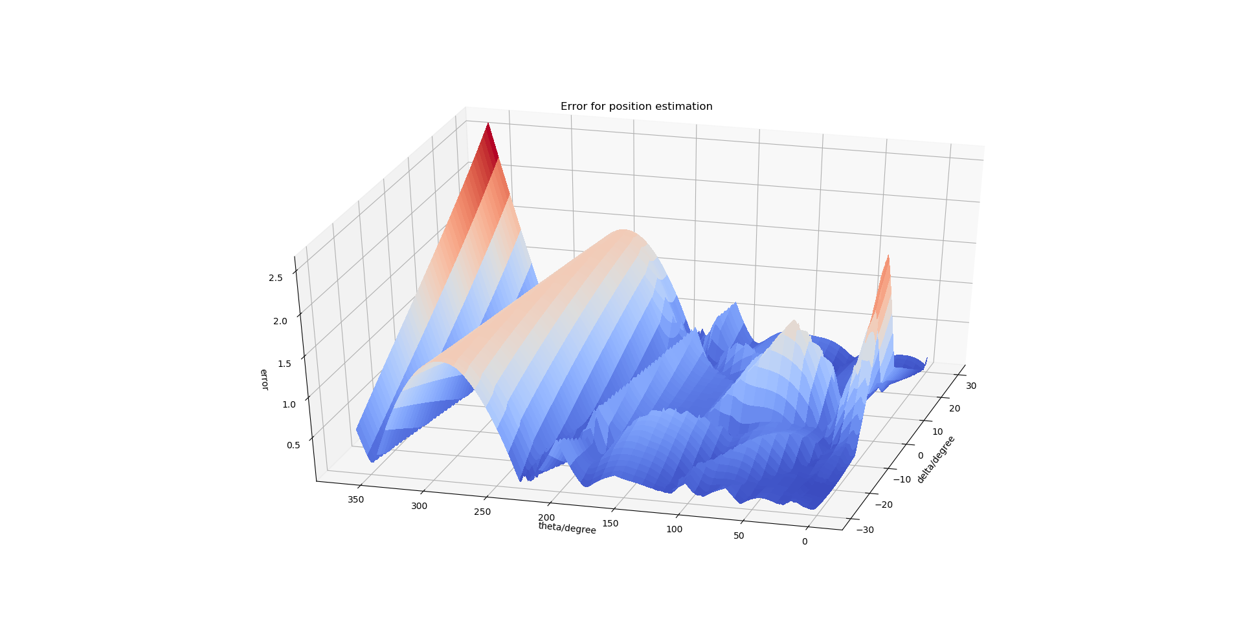
Experiment Result

